Slide 1

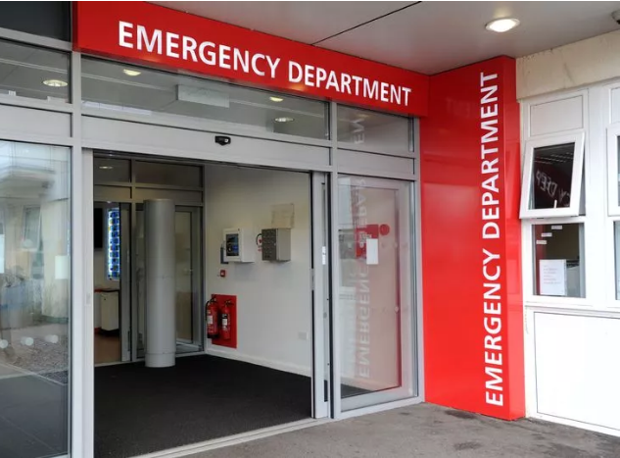
A Comprehensive Analysis of Hospital Emergency Rooms
- By Rishikesh More

Slide 2

Source (data.world)
About Dataset
What is data.world ? It is a platform which allows users to access data from various locations whether it is on premises or in cloud.
It has data in detailed manner regarding the emergency room similar to a record-keeping diary but in digital form.

Slide 3




Our Target Audience
Hospital Administrators: Runs and manage the hospital
Healthcare Policy Makers: Help in decision-making and with health policies
Medical Researchers : Professionals focused on analyzing patient data

Slide 4

Hospital Administrators:

Slide 5
Operational Efficiency: Efficient ER operations are crucial for prompt and effective patient treatment, impacting overall hospital performance.
Significance of Emergency Room
Most Visited: Responsible for more than half of all hospital admissions
Patient Flow Management: Understanding ER dynamics aids in optimizing patient flow, reducing wait times, and improving patient satisfaction.

Slide 6
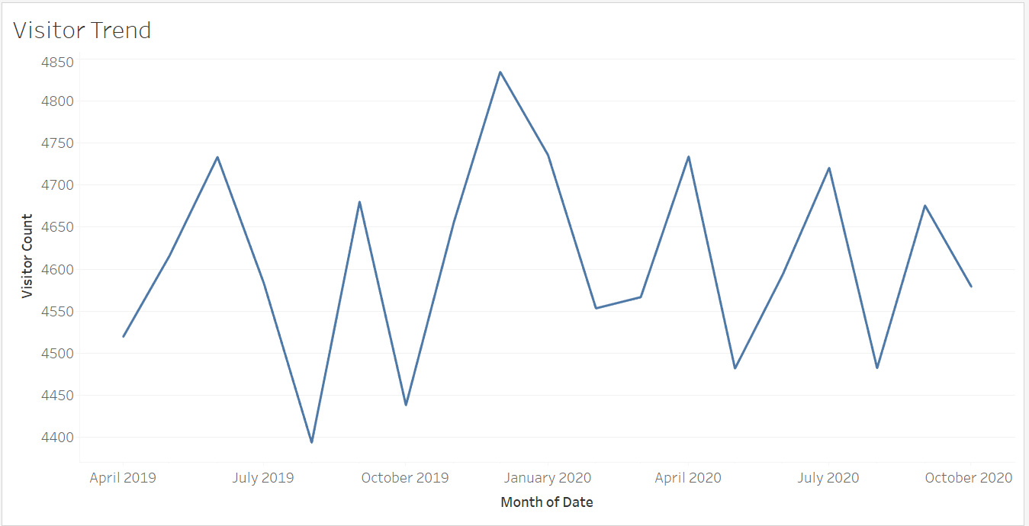
Key Trends: Visitor Trends Analysis
December Peak in Activity:
Significant Dip in August:
Increase: Roughly 35% uptick in ER visits
Reduction: Approximately 25% decrease in ER visits
Reasons for the Dip:
Causes for the Peak:
Seasonal rise in illnesses during the winter months
Ongoing summer vacations leading to fewer local ER visits
Reduced personal care due to holiday season
Lower prevalence of contagious diseases
School summer break resulting in fewer injuries among children

Slide 7
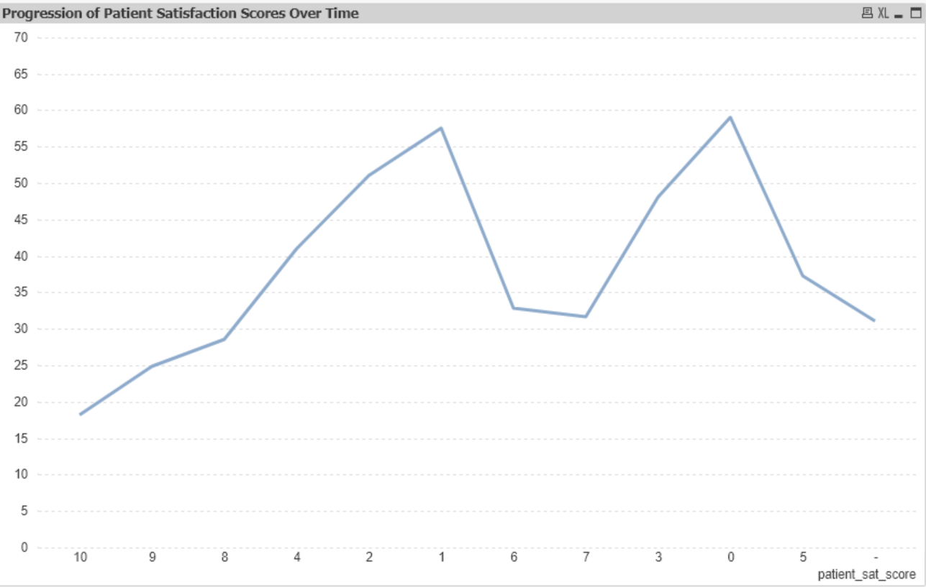
Other Insights : Patient Wait Times and Satisfaction
There is a clear pattern showing that the longer patients have to wait, the less satisfied they are with their hospital experience. The strength of this pattern is very high.
Patients typically wait around 39 minutes, but this can differ by about 15 minutes more or less. This big difference in wait times points out that there's a chance to make waiting times more consistent and possibly shorter.
The mean patient satisfaction score is slightly above 5 out of 10, with a standard deviation of around 3. This wide distribution implies that there is significant room for improvement in patient satisfaction scores, especially if strategies to reduce wait times are implemented.

Slide 8
Strategic Recommendations
Implement Queue Management Solutions: Adopt a queue management system to streamline patient flow, thereby reducing wait times and improving satisfaction scores.
Analyze Seasonal Trends: Investigate the causes of seasonal fluctuations in visitor numbers to better allocate resources during expected peak periods.
Standardize Processes: Develop standard operating procedures to minimize variability in patient wait times, aiming for a more predictable and efficient patient journey.

Slide 9
Closing Remarks
I invite any questions you may have and welcome a discussion on potential strategies to implement these recommendations.
By focusing on the highlighted areas, we can drive improvements in patient satisfaction and operational efficiency
Thank you for your attention to these insights.

Slide 10

Healthcare Policy Makers:

Slide 11
Significance of Emergency Room
Resource Allocation: ER analysis informs better allocation and utilization of resources like staff, equipment, and medical supplies.
Policy and Planning: Data-driven insights from ER analysis are vital for strategic planning, policy-making, and emergency preparedness.

Slide 12
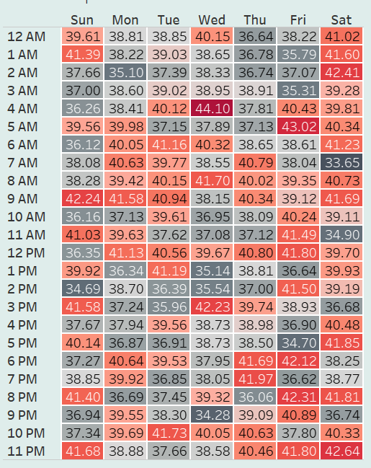
Key Trends: Wait Time Trends Analysis
Afternoons have shorter waits, with the lowest at 2 PM on Saturday, around 35 minutes.
Sundays and Saturdays, showing that early and late hours tend to be the busiest
Especially at 1 AM on Sundays and Fridays, with times over 41 minutes. Friday at 1 AM has the highest wait at nearly 42 minutes

Slide 13
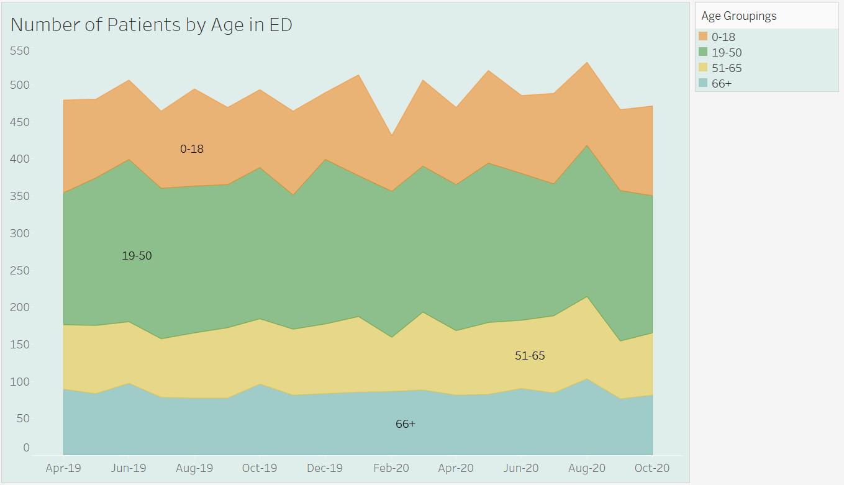
Other Insights : Patient Demographic Analysis
Adults between 19 and 50 years old visit the ED the most, indicating they often need urgent care.
People aged 51 to 65 also go to the ED, but not as much as the younger adults, showing they have fewer emergencies.
Seniors over 65 have the least number of visits, which might mean they have fewer health crises or don't use the ED as often.

Slide 14
Strategic Recommendations
Consider increasing medical staff during the identified peak times, especially on Friday and Sunday nights, to reduce wait times and improve patient flow and care.
Implement targeted health interventions or awareness campaigns aimed at the 19-50 age group to potentially reduce the frequency of their ED visits.
Explore the reasons behind lower ED usage by seniors aged 66+ to ensure they have adequate access to emergency healthcare services and are not avoiding necessary care.

Slide 15
Closing Remarks
I invite any questions you may have and welcome a discussion on potential strategies to implement these recommendations.
By focusing on the highlighted areas, we can drive improvements in patient satisfaction and operational efficiency
Thank you for your attention to these insights.

Slide 16

Medical Researchers :

Slide 17
Significance of Emergency Room
Critical Care Hub: ERs serve as the primary point for critical and urgent care, handling a diverse range of medical emergencies.
Quality of Care: Continuous analysis helps maintain high standards of care, ensuring that the ER responds effectively to patient needs.

Slide 18
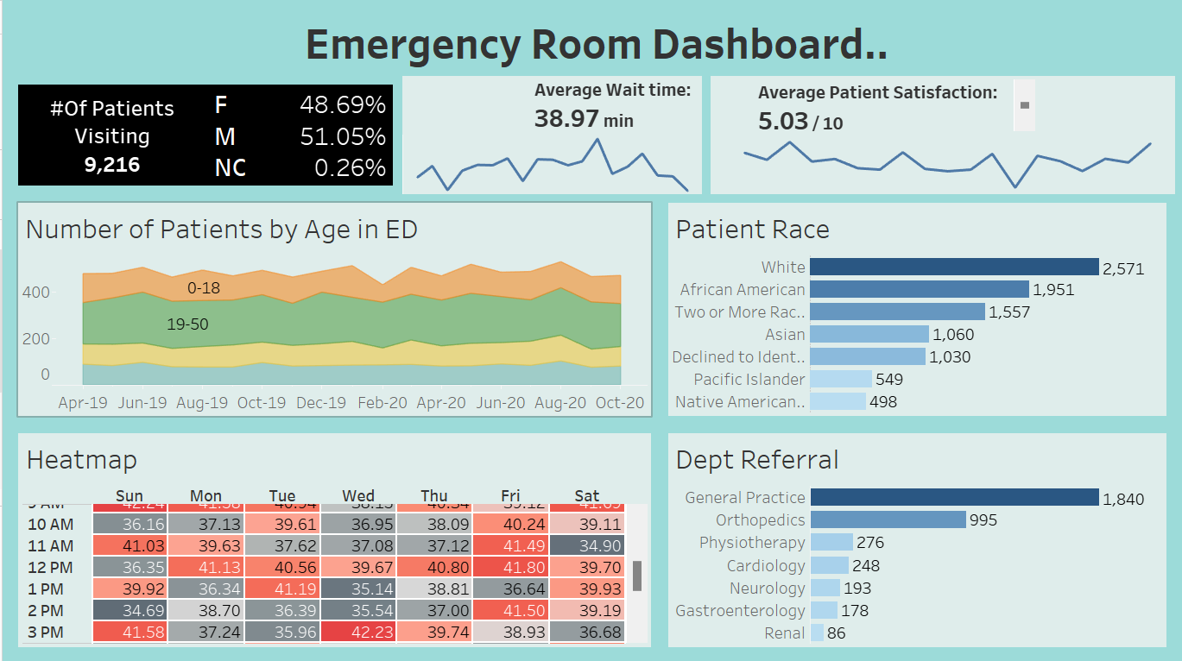
Emergency Room Visits Dashboard Overview

Slide 19
Emergency Room Visits Dashboard Overview
Quick Stats Overview:
Total patient visits: 9,216
Gender distribution: 48.69% female, 51.05% male, 0.26% non-conforming
Average wait time: 38.97 minutes
Average satisfaction: 5.03/10
Patient Age and Volume Trends:
Stacked area chart tracks patient age distribution over time
Clear visualization of patient volume changes within age groups
Demographic Breakdown by Race:
Bar chart details racial composition of patients
Highlights service usage across diverse populations
Wait Time Dynamics:
Heatmap showcases wait times by day and hour
Identifies when patients experience longer wait times
Departmental Referrals:
Bar chart indicates most frequent post-ER department referrals
Reveals potential patterns in patient care pathways
Insights for Research:
Enables quick spotting of trends, peak times, and potential care disparities
Supports evidence-based analysis for operational improvements and research

Slide 20
Strategic Recommendations
Staffing and Efficiency: Investigate optimal staffing levels during peak wait times to improve patient throughput.
Patient Experience: Conduct research into the determinants of patient satisfaction to guide quality improvement strategies
Care Disparities: Analyze demographic data to address disparities and promote equitable healthcare delivery.
Integrated Care Models: Study the referral patterns and develop integrated care models to streamline patient management post-ER visit.

Slide 21
Closing Remarks
I invite any questions you may have and welcome a discussion on potential strategies to implement these recommendations.
By focusing on the highlighted areas, we can drive improvements in patient satisfaction and operational efficiency
Thank you for your attention to these insights.

Slide 22

Thank You

